Slide 1


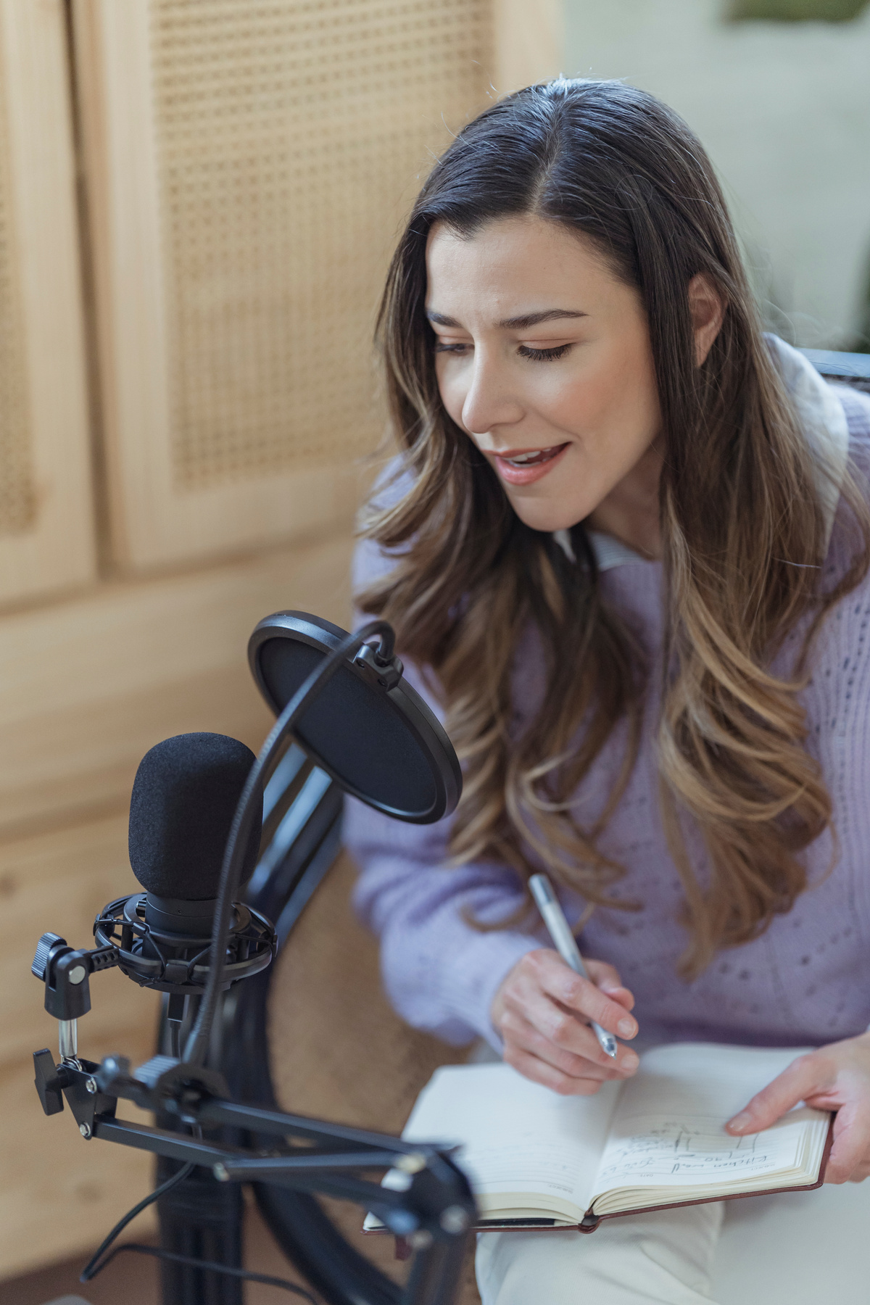


EXCLUSIVE
REALLYGREATSITE.COM
PODCAST
Eps
25
TALKS
New Episode
How to Build
A Digital Agency
Speaker:
Alice D. Grace
LISTEN NOW
JUNE 25, 2029
9.30 AM EST

